Slide 1
Sentiment analysis for EPARs

Slide 2
Agenda
Feasibility Analysis
Business case
Data profiling
Feasibility considerations
Further discussion
Productionalization
Architecture
Process of productionalization
Deployment
Monitoring plan (AKA what can go wrong...)
Tools for monitoring

Slide 3
Business case
regulatory ogranization needs an automated sentiment analysis tool that will help to quickly identify optimal/suboptimal clinical trial properties from widely acessible EPARs (European Public Assessment Report)
tool should be able to intake a file with extracted sentences, produce the predictions and deliver them to the user
user expects to see a sentence laballed as a phrase with „Positive”, „Negative” or „Neutral” sentiment
for labelling, subject matter experts are needed what makes building training dataset more of a challenge

Slide 4
Data profiling
Number of observations: 266 observations
Number of observations after duplicates removal: 233 (12% decrease)
Data quality check - no missing values, correct labeling
Inbalanced dataset: 60%, 27%, 12% for positive, neutral, negative classes
Number of features: after corpus cleaning* we have 971 unique words (on average 15 per sentence, after sentence preprocessing)
There are no visible, significant differences between most common words in positive, negative and neutral sentences
* lowercasing, steeming, lemmatization, removing nonalpha characters
Notes:
Q:
Is the dataset balanced?
Is the amount of data sufficient for allowing a hold-out dataset?
Do you have enough data to consider deep neural architectures or might good feature engineering with more shallow models suffice?

Slide 5
Data profiling – cntd.
Quick analysis shown that if positive sentence contains negative words, it’s quite often a negation, in different meaning than negative etc (ie. „risk is addressed”)
27% positive sentences contain negative word (38 out of 140)
Dataset contains a lot of domain-specific language, proper-nouns (names of product) as well as numbers and abbreviations.
One can expect that the dataset should not contain rhetorical modes like irony or sarcasm.
If one would follow rule-of-the-thumb train-test split of 80-20% and split the data proportionally, test set would contain 28/13/6 observation per label.

Slide 6
Feasibility considerations
Insights from data profiling
Sentiment Analysis results
Next steps

Slide 7
Further discussion
Instances with unclear sentiment
Model explainability
Error analysis
General view on EPARs analysis
Notes:
During the data collection process, for some sentences multiple experts disagreed on the sentiment of a given sentence, how could you capture such an ambiguity in your model and potentially notify users about such unclear instances?
How does your model come to a specific conclusion, what about model interpretability?
Think beyond the pure sentiment analysis of sentences, e.g. how would you automatically extract relevant sentences from EPARs and ensure that the analysis is only applied to specific sections? It is worth to explore some EPARs on the EMA website (e.g. consider the ones for Bayer products Eylea1 or Xarelto2).

Slide 8
How could an architecture to industrialize the sentiment analysis model look like?

Slide 9
Architecture
Assumptions:
batch processing
solution runs on AWS, organization uses Gitlab
data is provided in form of sentencies to analysis
runs on schedule or by demand
Additionally:
runs on schedule or by demand (triggered by the input file apperance)
solution could provide access to the sourced document and some general specifications along the labelled sentences

Slide 10
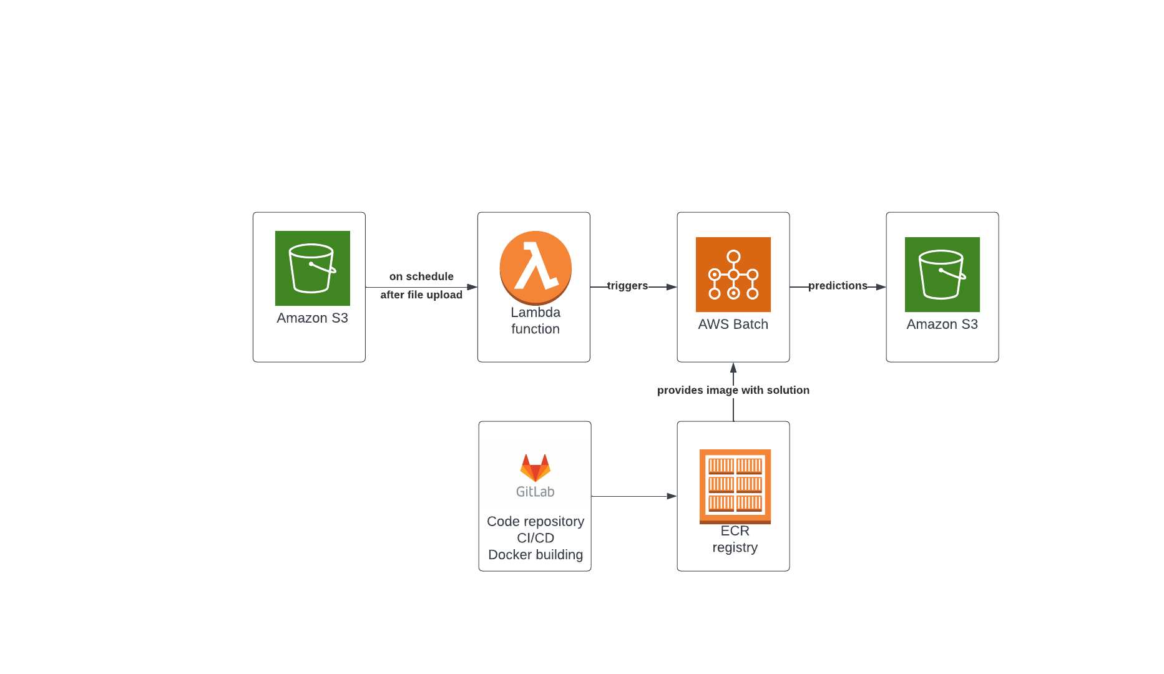
Architecture

Slide 11
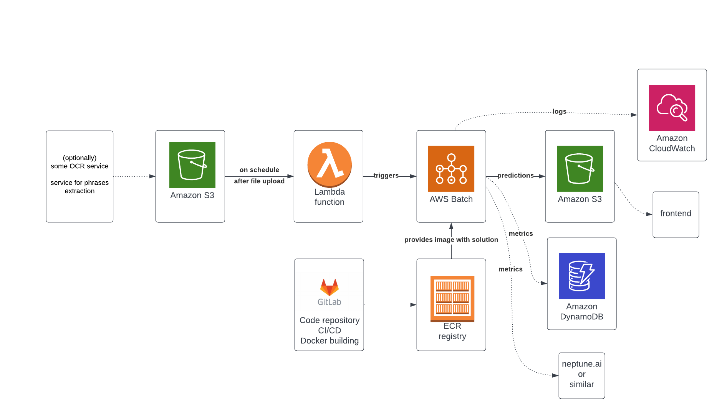
Architecture
Notes:
EC2 / Fargate
EC2, Fargate
AWS CICD tools

Slide 12
Productionalization plan
Assumptions: POC code prepared, model went through experimentation phase and is ready to be operationalized
pipeline building (data engineering)
CI/CD setup w/development flow
code industrialization, ie: refactorization/modularization to achieve production-ready code, unit testing, logging, data import/export handling, data validation (sanity checks), building monitoring
testing the pipeline and industralized solution
deployment (different possible strategies)
monitoring/retraining/testing
documentation and service recovery strategies

Slide 13
What could go wrong in the long run once the model is deployed and used on live data?

Slide 14
What can go wrong?
ML monitoring:
input data can be missing column with sentences (data quality issue | sanity checks needed)
there is a sharp increase in negative assestments in EPARs (change data distr. |data drift monitoring needed)
change in EMA regulations affects sentiment (model drift monitoring needed)
increase in amount of inference requests (throughput limitations, increasins costs | flexible architecture and cost monitoring needed)
sentence extraction mechanism provides wrong kind of sentences (data quality issue | data drift monitoring and scoring monitoring needed)
etc...

Slide 15
Monitoring plan
ML monitoring:
input data (data quality problems, data distribution/data drift, outliers)
model monitoring (versioning, configuration, training metrics)
predictions (archiving predictions, evaluation of performance, model drift)
Other:
E2E pipeline monitoring
cost monitoring
Latency/throughput monitoring

Slide 16
What tools and methodologies would be helpful to maintain the model also in the long run?

Slide 17
Tools and methods for monitoring
Methods:
- in code: data validation (quality checks, data distributions), metrics outputting and logging
- pipeline: alert mechanisms when error/warnings occur
- error analysis
Tools:
- metrics gathering tool, ie. Neptune AI (predictions, input data monitoring, performance etc) or on AWS platform, ie. Dynamo DB
- email notification for situation that require action – AWS Lambda
- logging – AWS Cloud Watch

Slide 18
Thank you for your attention.

Slide 19
Metric | Input data / predictions | Sanity check / metrics
Accuracy | Predictions | Model monitoring
F1 Score | Predictions | Model monitoring
Features distributions | Input data | Model monitoring
Outliers check | Input data | Sanity check
Non empty values | Input data | Sanity check
Sentences similarity | Input data | Model monitoring
Number of features | Input data | Model monitoring

Slide 20
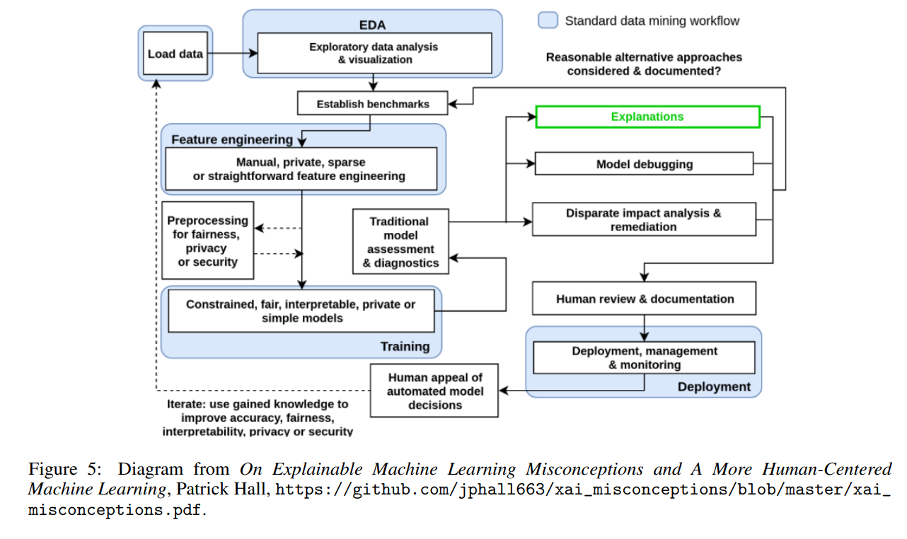
Different points of view...
arXiv:1907.04461v1 [cs.LG] 9 Jul 2019

Slide 21
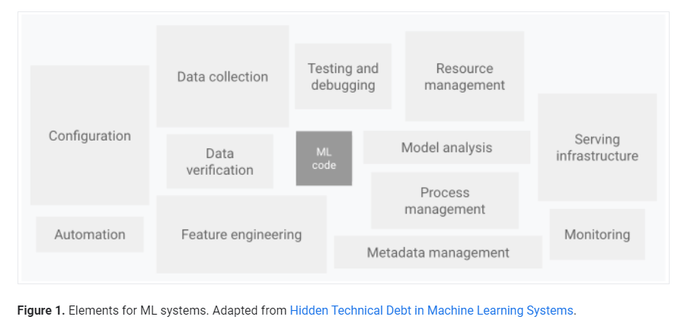
Different points of view...
https://cloud.google.com/architecture/mlops-continuous-delivery-and-automation-pipelines-in-machine-learning

Slide 22
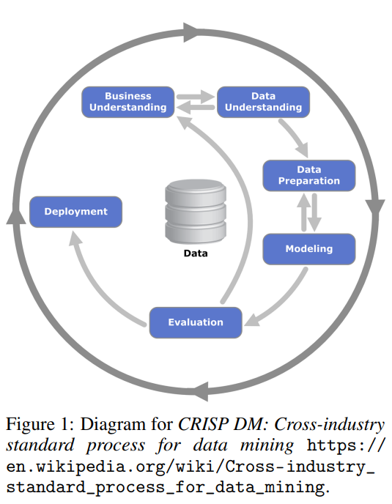
CRISP DM
arXiv:1907.04461v1 [cs.LG] 9 Jul 2019

